Slide 1
ODS Data Sleuth
Tracking Down Calculated Fields in Banner
Presented by: Bryan Mack Colorado Community College System
April 7, 2014
Session ID 2502

Slide 2
Session Rules of Etiquette
Please turn off your cell phone/pager
If you must leave the session early, please do so as discreetly as possible
Please avoid side conversation during the session
Thank you for your cooperation!

Slide 3
About CCCS
Comprised of 13 community colleges & a central system office
162K active students
VPD/MEP environment
ODS 8.4.1 – Streams
BI team includes our Director, a Cognos Admin, a DBA, and 4 developers

Slide 4
Introduction
This presentation is technical; it involves extending the ODS in a more involved way than a simple ETL customization.
The goal of the actions of this presentation are to allow for reporting upon complex data subjects which are not delivered to the ODS.

Slide 5
Agenda
Do’s and Don'ts
Walk through of two CCCS cases
Using basic calculations
2) Creating new database objects
a) Composite View/Table & Reporting View + ETL
b) Packages/Functions

Slide 6
Do’s and Don’ts
DO
Trust what the code says
DON’T
Trust what a user thinks without facts to back it up

Slide 7
Do’s and Don’ts
DO
Use your fellow developers outside of ODS-land. Use project managers who completely understand your data.
DON’T
Trust what a user thinks without facts to back it up

Slide 8
Do’s and Don’ts
DO
Use the ODS metadata,Oracle’s DBA views, and other resources to help you track fields down
DON’T
Trust what a user thinks without facts to back it up

Slide 9
Case 1 – Using Basic Calculations
The Original User Request
“Hi! Can you make me a Cognos report about employment benefits? Do you need any more information than this? Can I have it by tomorrow?”

Slide 10
Initial Report Requst
Ok – maybe it wasn’t that bad. Here’s the real request:
This report will identify all optional deductions an employee can elect during open enrollment. HR Administrators verify the data entry with this report and run it multiple times during open enrollment. They currently have to request this from the PM and it has to be parsed out to the produpdate folder for each school.

Slide 11

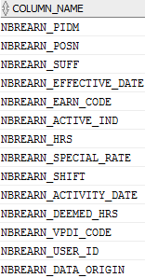
The Problem
This user required the END_DATE to be populated in the report. The END_DATE is not stored in the database as it appears on the form.
It displays on the form →
There is no end date field in the table →

Slide 12
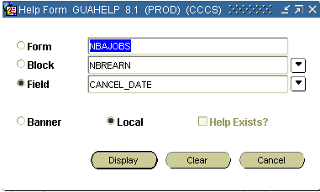
Solving The Problem
A project manager with Banner access provided us this info from NBAJOBS regarding this field:
NBAJOBS.CANCEL_DATE

Slide 13
Discovering a Calculated Value
As basic Banner/ODS knowledge tells us, “CANCEL_DATE” is not a stored value within a Banner table as the field name does not begin with a 7-character table name
This indicates a calculated value.
We must reverse-engineer this field to reproduce the calculation in the ODS

Slide 14
The solution is obviously quite simple
Step 1: Ask the user for the calculation behind the field. They know this 100% of the time and will never, ever, under any circumstances, give you an answer which could even be misconstrued as incorrect in any way, shape or form.

Slide 15
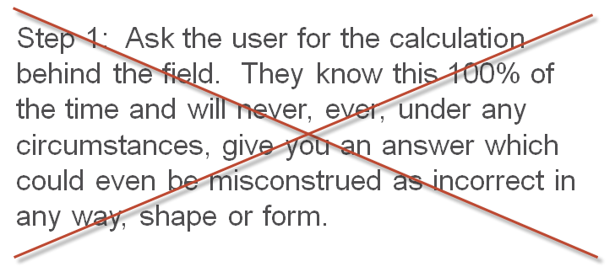
TRY AGAIN!

Slide 16
Tracking down a calculated field
Step 1: Ask someone with Banner form access for the code behind the form. In this case, the form is NBAJOBS.

Slide 17
Tracking down a calculated field
We determined the cancel_date is really the (effective_date – 1) of another row.
When an earning code on NBAJOBS is set to end, a user manually types in an end date into the end-date field of the row. This then creates a new row in NBREARN (row 2) with the effective date equal to the date they just typed in + 1. This new “effective_date” for row 2 is stored in the database (if the form is saved after entering the new row); the end date which was typed in is not stored in the database. We need to calculate the end date in the same manner.*
*There is a bit more to it than this, but we are just going high-level in this presentation

Slide 18
Huh?
To be honest, that previous slide doesn’t matter and you don’t need to understand it. That might be a cop out since I barely understand it.
The point is, that logic found in the Banner packages needs to be reproduced in the ODS.

Slide 19
Tracking down a calculated field
We can place the following code right into our report without the need to create a database object to store the data.
(lead(effective_date,1) over (partition by person_uid, (CASE
WHEN earn_code IN ('BDF','BDS') then 'Dental'
WHEN earn_code IN ('BHF','BHS','BEO') then 'Health'
WHEN earn_code IN ('BLS') then 'Life'
ELSE null
END)
order by effective_date asc, earn_code, active_ind desc)-1) as end_date

Slide 20
The Point
The point to take home from this case is to trust the code behind the Banner form rather than to play the guessing game or use what works in most cases. The code will work 100% of the time.

Slide 21
Case 2 – Using Database Objects
The Original User Request
The user needs to report the financial aid field “Unmet Need”
The user reported this field to simply be: RORSTAT_UNMET_NEED

Slide 22
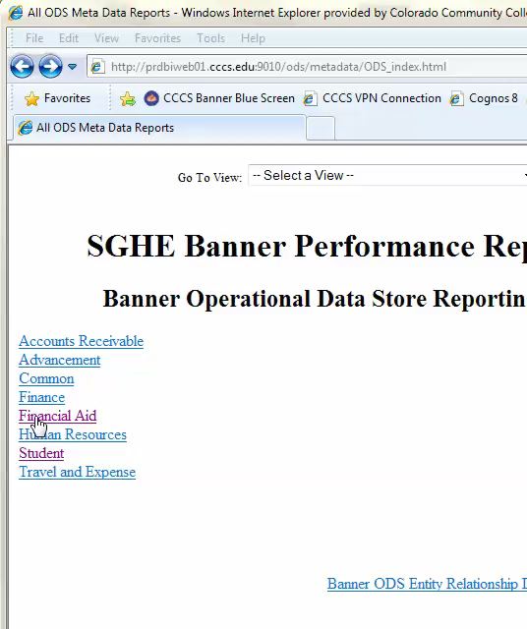
Finding the field
Our first way of finding this field is to check the metadata to see if it is delivered to the ODS.
Search the metadata for RORSTAT_UNMET_NEED
It doesn’t appear to be there.

Slide 23
Finding the field
Don’t always trust the metadata, it’s best to check dba_source and/or dba_dependencies to see where this field may be hidden in case it has weaseled its way into the ODS:
select * from dba_dependencies where referenced_name = 'RORSTAT';
select * from dba_source where lower(text) like '%rorstat_unmet_need%‘;
It can’t hurt to check the source code of any source views these queries return to see if the object already exists in the ODS.

Slide 24
Finding the field
Let’s assume the last slide returned nothing. Which is a safe assumption, because it didn’t.
We have a few options to get this into a report in the ODS:
Join your data directly to RORSTAT or write a function to bring this field in directly from RORSTAT
Technically a possibility, but a bad idea to join real-time (streamed) data to day-old ODS data
2) Create new custom versions of a composite view, composite table, and reporting view which contain the new field you wish to report upon.
Getting warmer here, but this isn’t the real answer in this case. Why?

Slide 25
Finding the field
In my example, I set up the custom database objects to get RORSTAT_UNMET_NEED into the ODS and thus, on the report. That field is what the user requested, and I didn’t listen to my own rules about backing things up with facts.
Shortly after the report was developed, we ran into this:
Total Award and Unmet Need is not displayed for most in the spreadsheet. I did find a student who had the Total Award showing, but it was calculated incorrectly. The student is S######## and the Total Award = EFC plus Private scholarship. The Unmet Need is showing too. It is negative due to private scholarship. For S########, it looks like the total offered aid and the EFC (or budget) were added together to get the Total Award number and haven’t a clue how to guess where the Unmet Need calculated (it is negative the whole financial aid package total).

Slide 26
So why is the data wrong?
The user requested RORSTAT_UNMET_NEED erroneously.
Remember the rule of “don’t trust what a user thinks without facts to back it up”. Well, I didn’t obey.
Email: “I checked them all for aid year 1213, in both PROD and TEST, and I see no values for unmet need. Where are you getting the numbers you have on the excel sheet you attached? Per the report request specs, I have been using rorstat_unmet_need.
I have a feeling that unmet need might be a calculated field rather than stored in the database.”

Slide 27
Mistake #1
This case presents a bad assumption on my part. I assumed the user was correct in suggesting we use RORSTAT_UNMET_NEED. Thus, I wasted much time creating a custom composite view, composite table, and reporting view – then creating and scheduling a new ETL refresh…. Only to find out this was the wrong field.

Slide 28
Mistake #2
I next took the user’s word for it when given a formula:
“We’ll have to take the Student Budget, subtract the EFC. That will give you GROSS NEED. To get UNMET NEED you will need to them subtract awarded aid (with the exception of unsubsidized Stafford loans)”… etc. etc. etc.

Slide 29
Learning from Mistake #2
This still didn’t correct this issue, as we determined “The unmet need formula he/she gave me works only when an individual has EFC = $0”
This is getting silly…. Let’s get this done correctly once and for all.

Slide 30
The Solution
Work with a Banner developer to find the code behind the form. They usually charge you a bag of Skittles for their services. In this case, it turned out we needed several functions out of the Banner package RNKNEED. The final formula we derived from this was:
(BUDGET-EFC-RESOURCES) – FUNDS THAT REDUCE NEED – MAX[(Funds that replace EFC – EFC),0] = UNMET NEED

Slide 31
Translating Functions
There were several functions within RNKNEED that we needed to bring over to the ODS for this calculation. We store them in a package called ZRKFUNC. This mimics the ODS package-naming scheme, only CCCS uses “Z” as the first character for custom packages.

Slide 32
Translating Functions
Using the delivered metadata, we are going to translate all fields in the RNKNEED functions to use ODS fields so that data is all in synch (ODS data mixed with current Banner data). For example, within RNKNEED.F_CALC_CONTRACTS, there is a cursor CALC_CONTRACT_AMT_C:
SELECT SUM(NVL(DECODE(f_calc_contract_payment(TBBCSTU_STU_PIDM, -- 60400
TBBCSTU_CONTRACT_PIDM,
TBBCSTU_CONTRACT_NUMBER,
TBBCSTU_TERM_CODE),
'',DECODE(assume_full_time_ind_v,
Look up each banner field name in the metadata to translate to ODS fields:

Slide 33
Translating Functions
Break down the entire function this way until you’re left with a version of the function that has replaced all Banner field names with ODS field names.
NOTE: Your joins may change slightly based on cardinality
So this….. | Becomes this….
SELECT ’43-8' FROM RPRCONT, TBBCSTU <joins> WHERE NVL(TBBCSTU_DEL_IND,'X') <> 'D‘ | SELECT ’43-8' FROM mtt_contract m WHERE NVL(m.student_inactivated_ind,'X') <> 'Y‘

Slide 34
Translating Functions
We ended up writing 12 functions in order to calculate Unmet Need the exact way it is calculated within Banner:
f_calc_awd_reduce_need f_calc_coa f_calc_contracts
f_calc_gross_need f_calc_load
f_calc_oth_resource
f_calc_pell_efc f_calc_pell_replacement
f_calc_total_awards
f_calc_total_non_need
f_calc_total_resource
f_calc_unmet_need

Slide 35
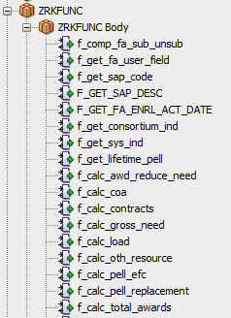
ZRKFUNC

Slide 36
Simple Report Code
Select zrkfunc.f_calc_unmet_need(person_uid, aid_year, multi_source) as unmet_need
FROM <whatever I’m selecting from>

Slide 37
Questions & Answers
??

Slide 38
Thank You!
Bryan Mack
Bryan.Mack@cccs.edu
Please complete the online session evaluation form
Session ID 2502
.
© 2014 Ellucian. All rights reserved.

